Slide 1
G: Alternative MCMC algorithms
Day 3: 09h30-10h00

Slide 2
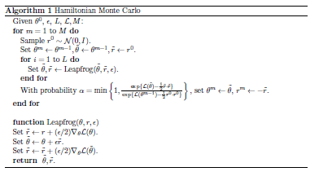
Hamiltonian Monte Carlo-I
Hamiltonian Monte Carlo uses the gradient of the log-likelihood function as the basis of the jump function

Slide 3
Hamiltonian Monte Carlo-II
A challenge with this sampler is that it requires that L and ε be set by the user – unfortunately the performance of the algorithm can depend quite substantially on the values for these parameters.

Slide 4
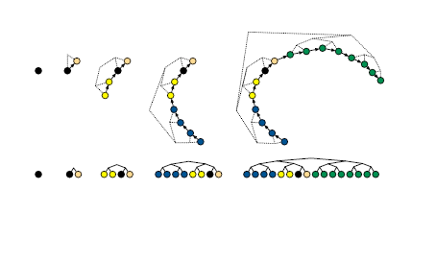
No-U-Turn Sampler-I
The idea behind the (naïve) no-U-turn sampler is keep moving on a path until the path starts to bend back on itself (has a U-turn).

Slide 5
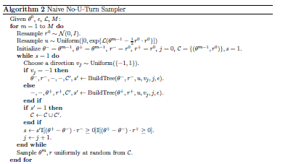
No-U-Turn Sampler-II

Slide 6
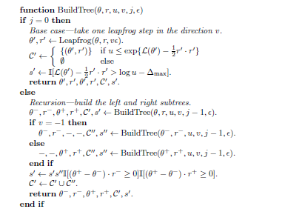
No-U-Turn Sampler-III

Slide 7
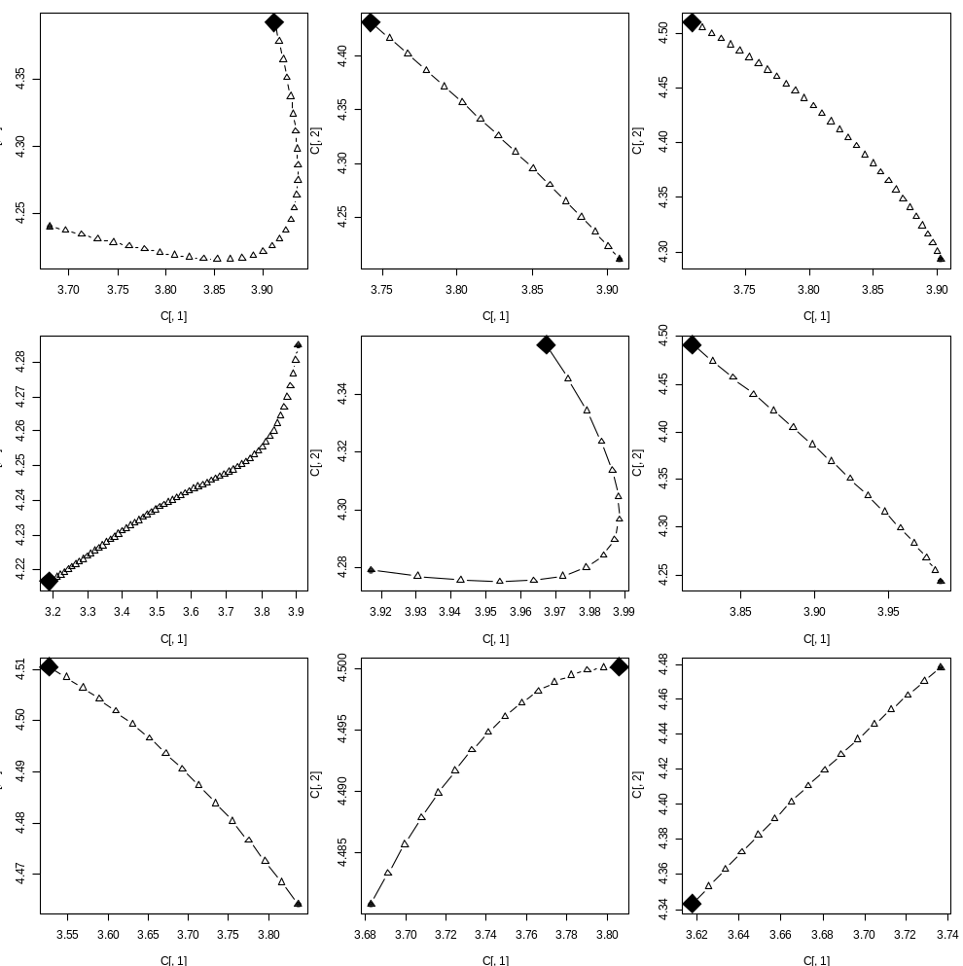
Application to LectF
This is a 3-parameter model, but when it is constrained to only 2 parameters the behaviour of NUTS is easier to see.

Slide 8
No-U-Turn Sampler-IV
The No-U-turn sampler does not require that L be specified. However, algorithms are available:
to make the sampler more efficient; and
automatically select ε.
These extensions are available in adnuts.

Slide 9
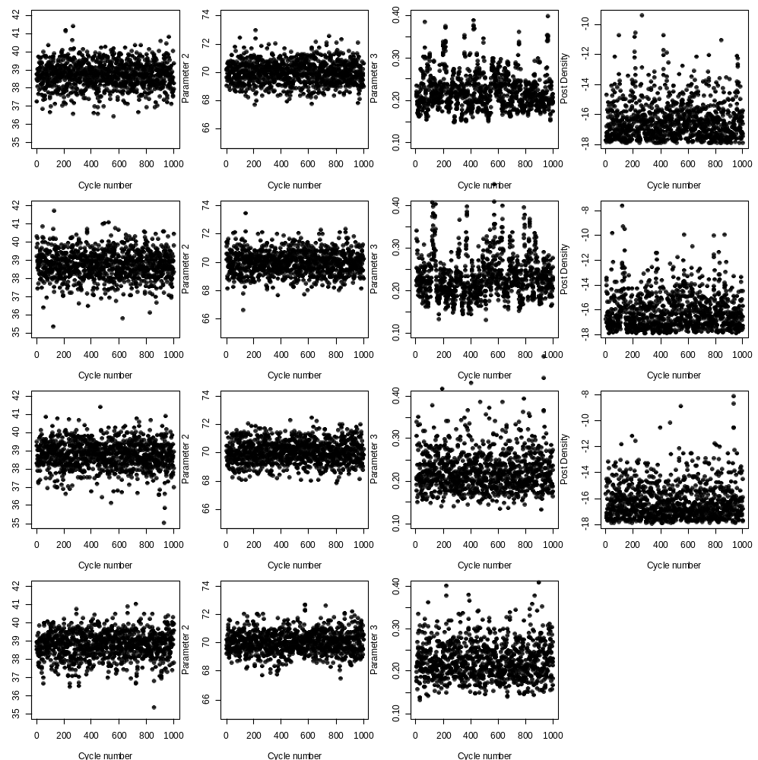
Naïve NUTS
Hamiltonian
MCMC with a normal jump function
NUTS in adnuts

Slide 10
Reference
Hoffman, M.D. and A. Gelman. 2014. The No-U-Turn Sampler: Adaptively Setting Path Lengths in Hamiltonian Monte Carlo. Journal of Machine Learning. 15: 1361-1381.

